Slide 1
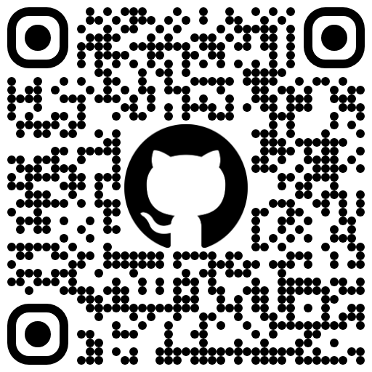
GIT & Project Management
Phu Thai
09/22/2025

Slide 2

About me
GIT & Project Management
| Software Engineer in Azure Software Defined Networking
| Manage IP Address Management + Regional Network Manager
| B.S in Computer + Systems Engineering
| Ongoing MLA in Data Science
Phu Thai
Microsoft

Slide 3
GIT
GIT & Project Management

Slide 4


Version Control Overview
What happens when there’s no source control?

Slide 5

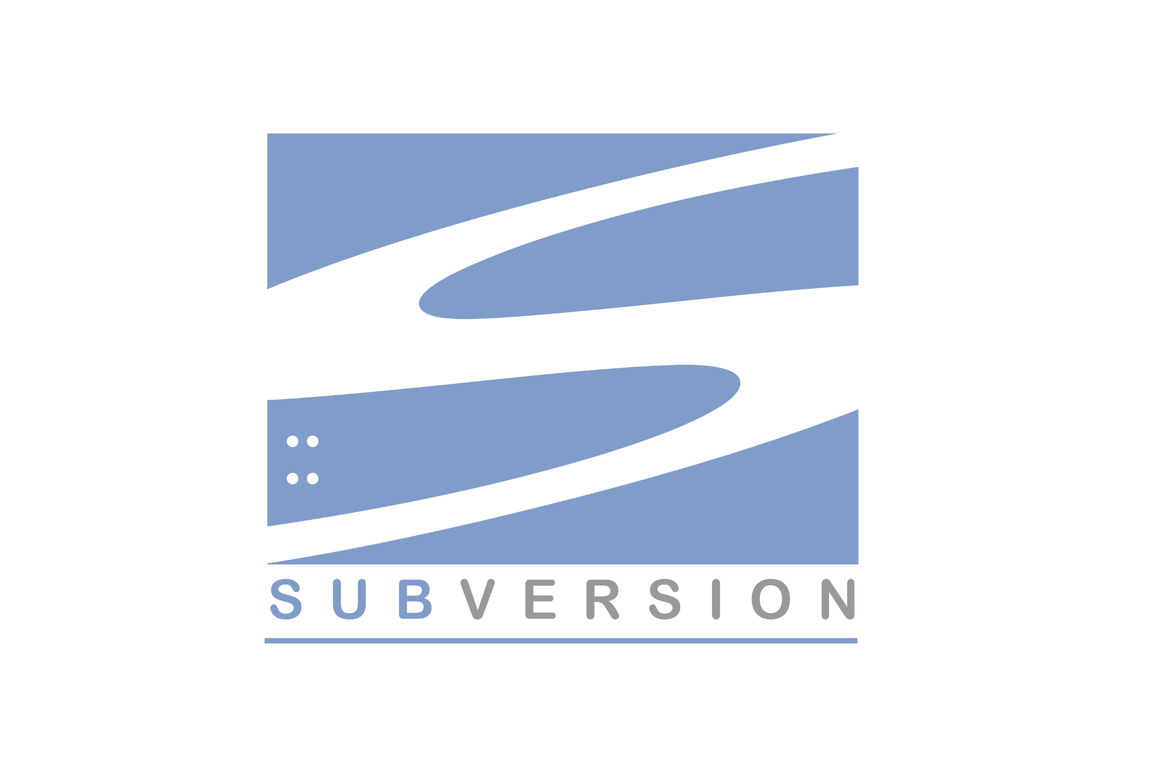
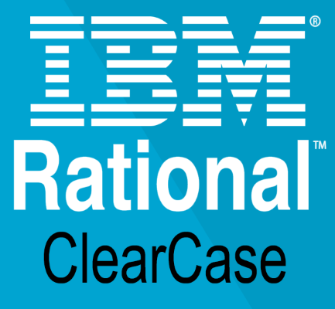

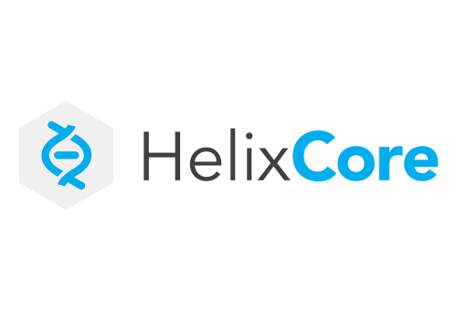
Version Control Overview
Centralized

Slide 6


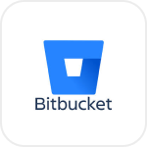

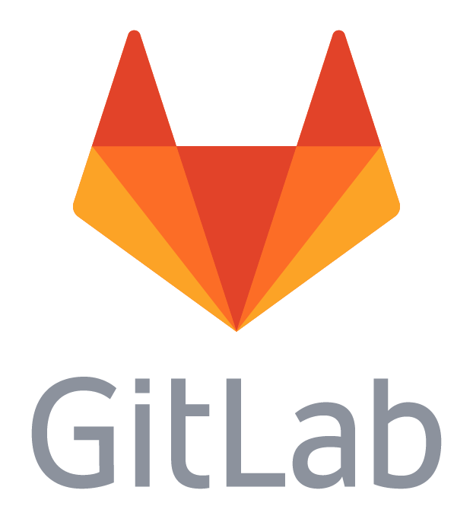
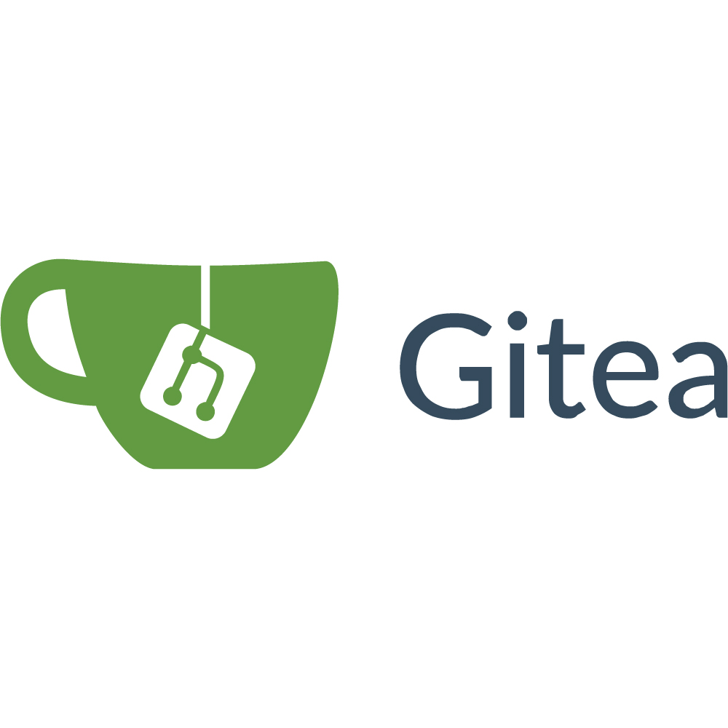
Version Control Overview
Decentralized

Slide 7

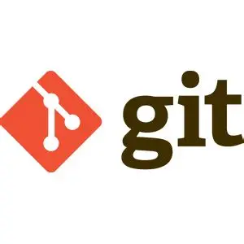
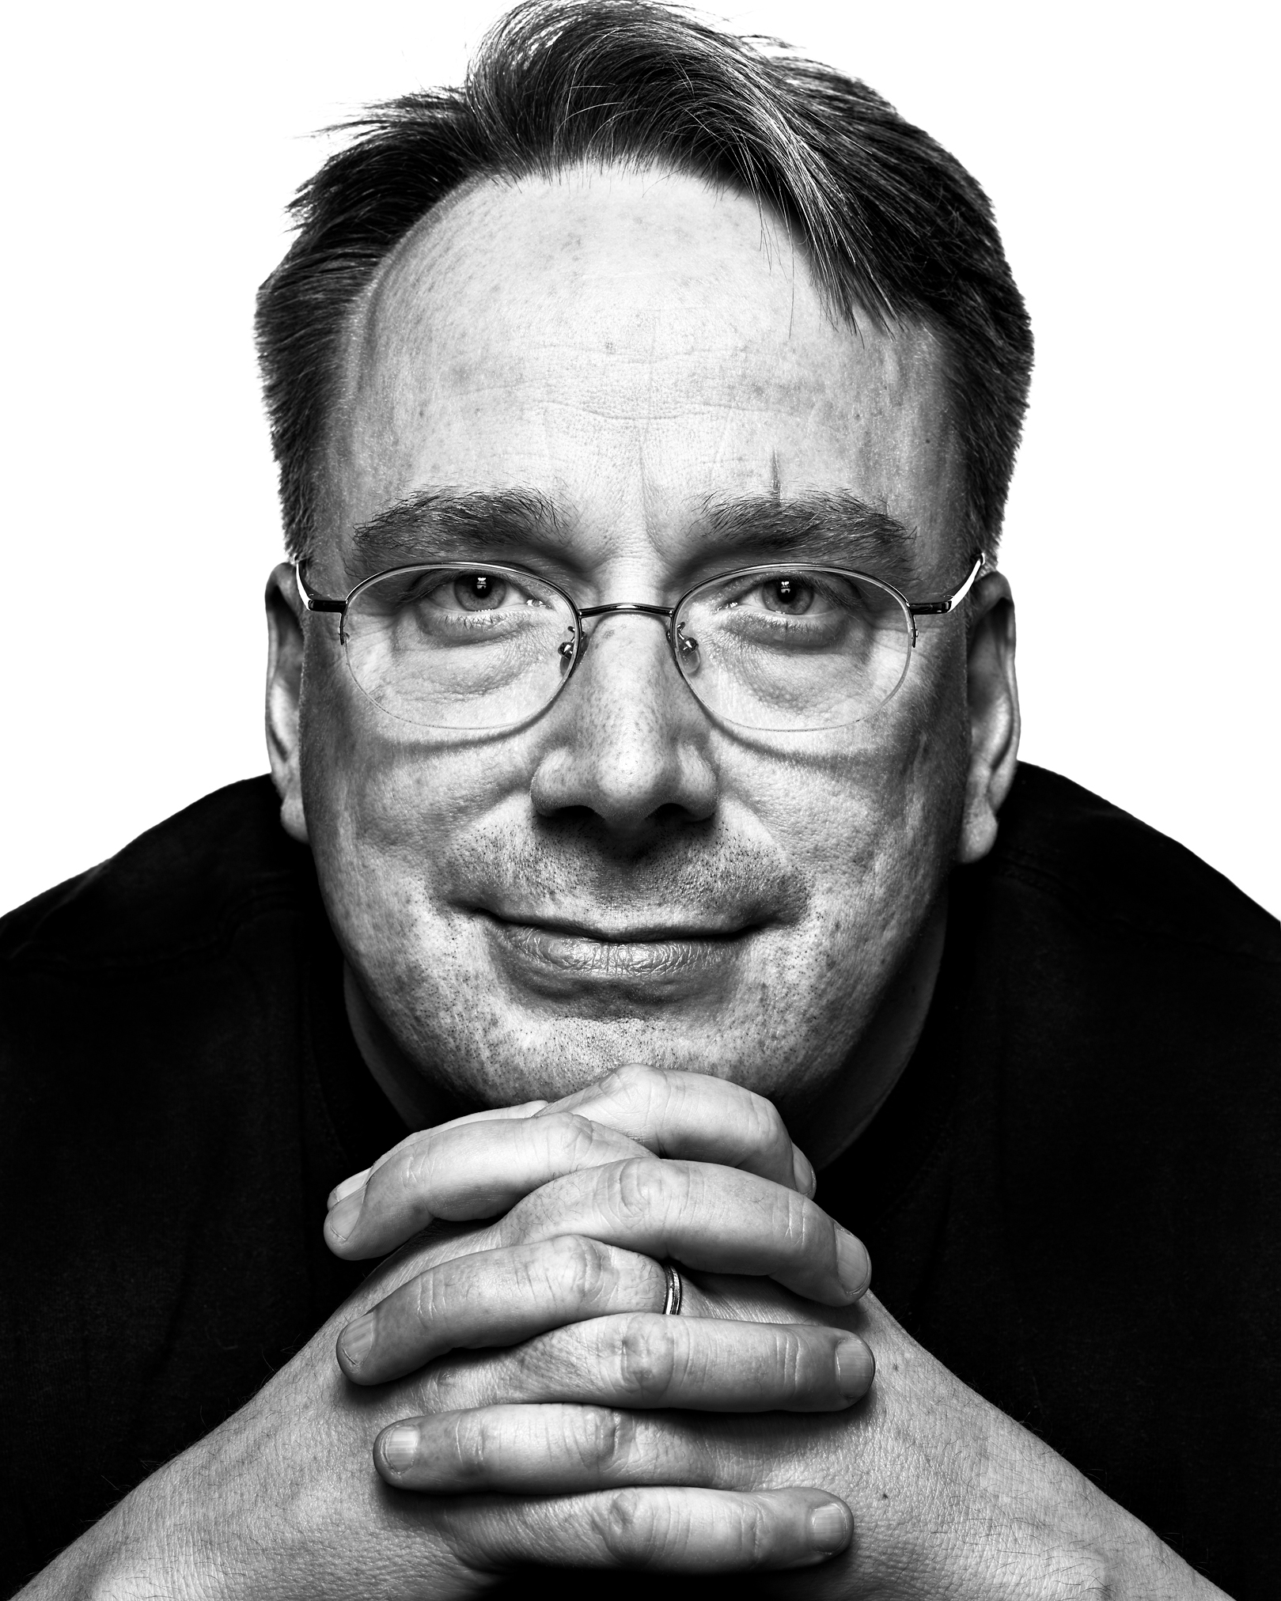
History of GIT
Linus Torvalds
GIT & Project Management
1990s: The Linux Kernel was Open Source
2002: The Linux team adopted BitKeeper as a version control system
2005: Deteriorating relationships led to BitKeeper’s free license to be revoked
= Leads to the birth of Git
Creator of Linux + Git
April 7, 2005 | First commit titled “the information manager from hell”

Slide 8

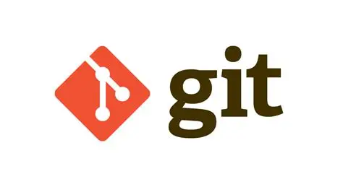
Clearing Up a Common Misconception
!=

Slide 9
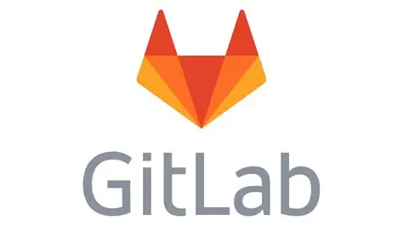
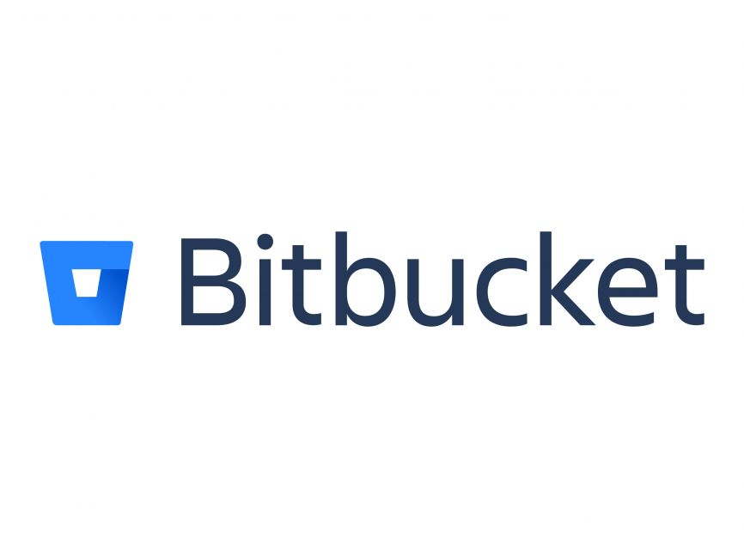

Clearing Up a Common Misconception
Type | Tool | Platforms
Offline Work? | True | False
Hosting | Local | Cloud
User Interface | CLI | Web-based
Note | Built in 2005 1st major platform (Github) coming in 2008 | Build on top of Git

Slide 10
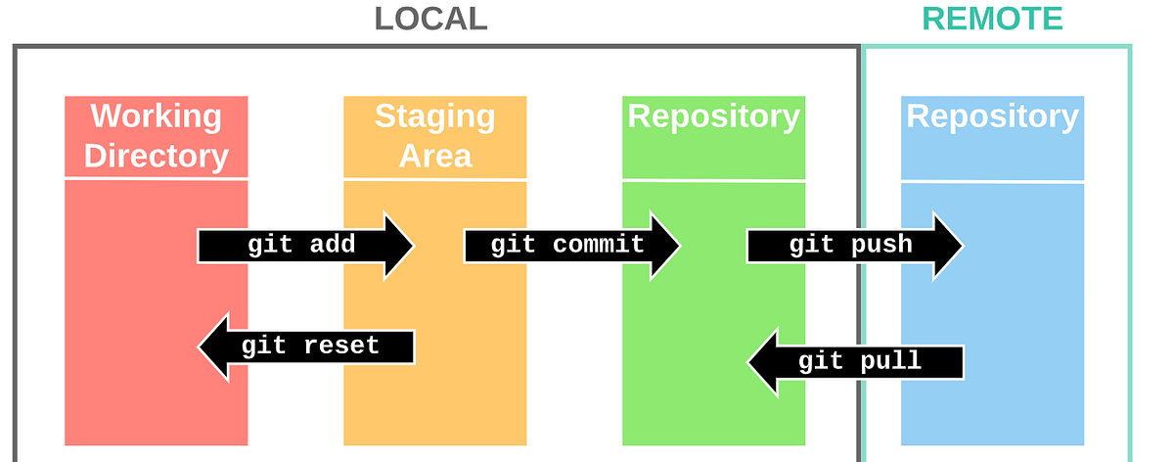
How Git Works | Developer Flow

Slide 11
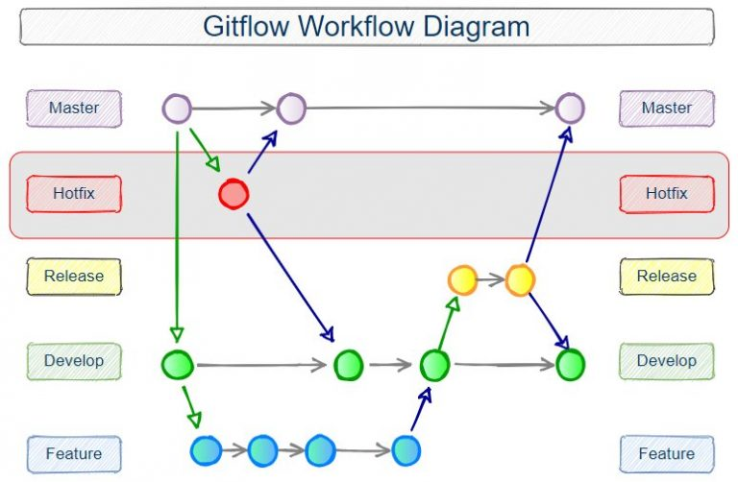
How Git Works | Overall Workflow

Slide 12
GitOps
–
Common Conventions
Branch Naming | git checkout -b “<username>/title” Ex: git checkout -b “phuthai/Presentation” git checkout -b “<feature/bugfix/request>/title” Ex: git checkout -b “feature/Presentation”
“Commit Early, Commit Often”
Adding Type Messages to Commits | Common types: feat, fix, docs, style, refactor, test, chore Ex: git commit -m “feat(slides): added 1st slide”
Delete branches that have merged
Create draft PRs early
……. (and many more!)

Slide 13
PROJECT MANAGEMENT
GIT & Project Management

Slide 14

Overview
GIT & Project Management
Key Components of Effective Project Management
Planning: Define scope, timeline, and resources.
Execution: Coordinate tasks, manage teams, and track progress.
Monitoring & Control: Use KPIs and dashboards to stay on track.
Communication: Ensure transparency across stakeholders.
Risk Management: Identify and mitigate potential issues early.
How do we manage a team to–
deliver on time?
stay within budget?
hit quality standards?
exceed customer expectations?
collaborate effectively?
…
Every company/contract/project does things differently!

Slide 15
Scenario
GIT & Project Management
You and your classmates are tasked to write a research paper with a 6 week deadline

Slide 16
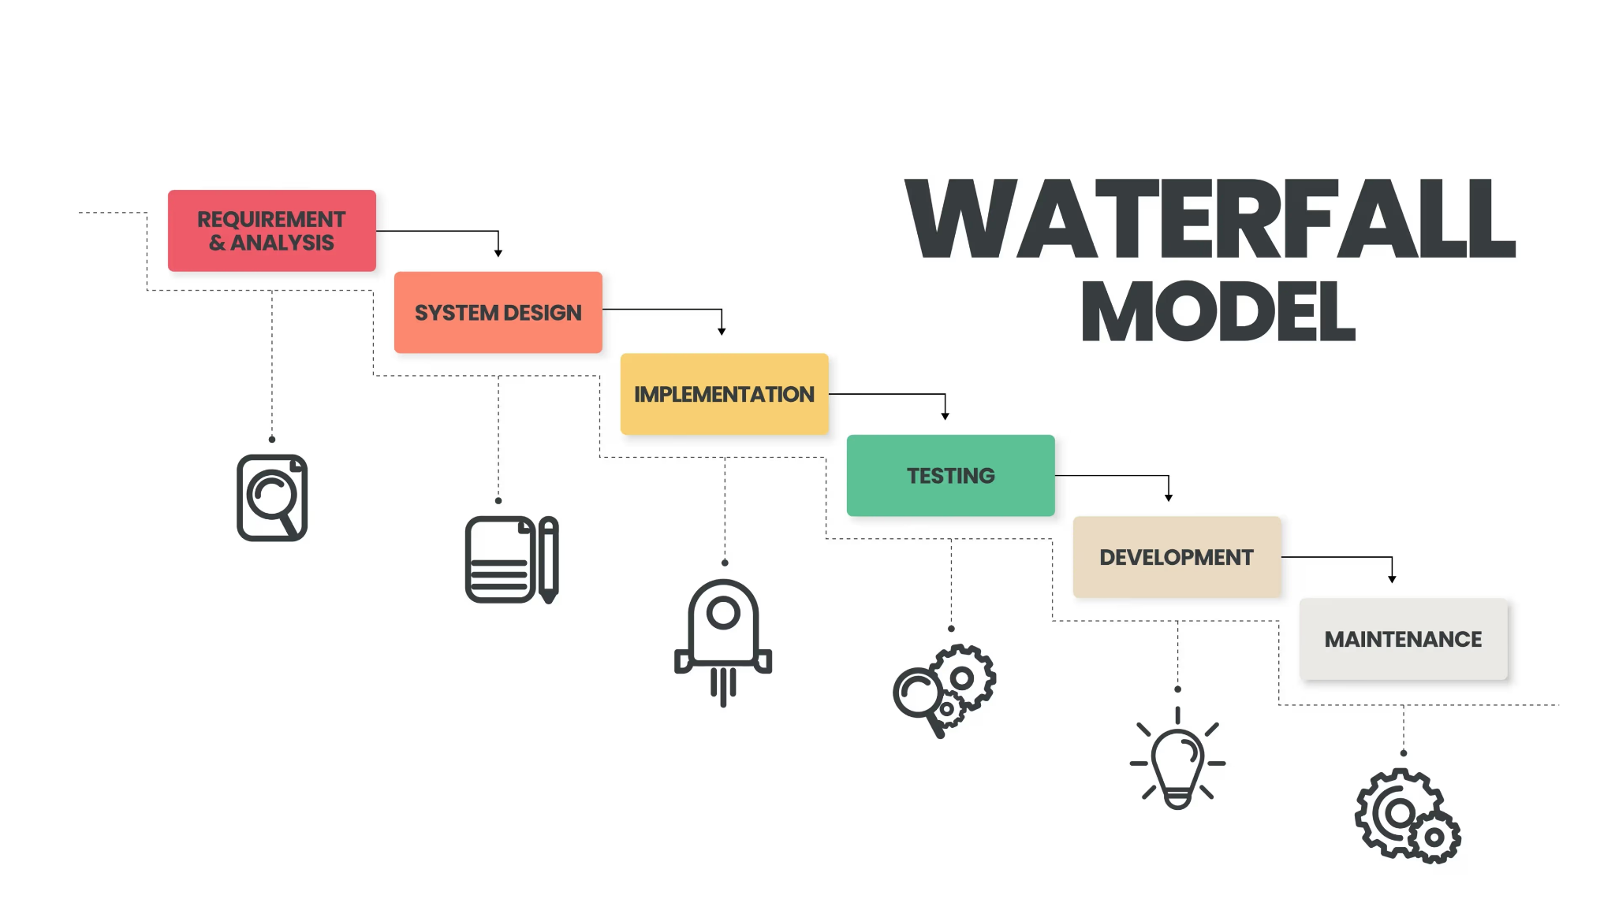
Waterfall
GIT & Project Management

Slide 17
Waterfall
GIT & Project Management
One of the simpler models, very common in school.
Pros:
Everyone’s on the same page
Cons:
Difficult to adapt to change
Work is done sequentially
Applying The Scenario:
Decide on the topic
Do the research
Write the Intro
Write the Body
Write the Conclusion
Edit + Submit
All done sequentially

Slide 18

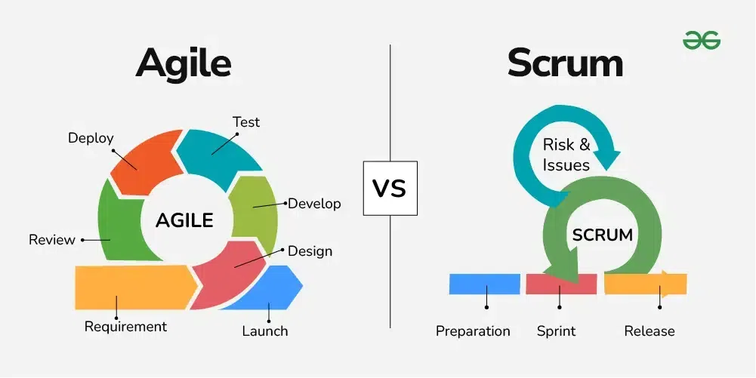
Agile | Scrum
GIT & Project Management

Slide 19
Agile | Scrum
GIT & Project Management
The most common framework
Agile = mindset of building software in small steps
Scrum = One of many ways to do Agile
Pros:
Flexible + iterative
Work can be parallelized
Cons:
Constant check-ins
Lots of planning
Applying The Scenario:
Split the 6 week deadline into 2 week “sprints” (3 sprints total)
Sprint #:
Everyone write the intro + research their own section of the body
Everyone write the body and review/revise Sprint 1
Everyone write the conclusion + review Sprint 1 + 2

Slide 20

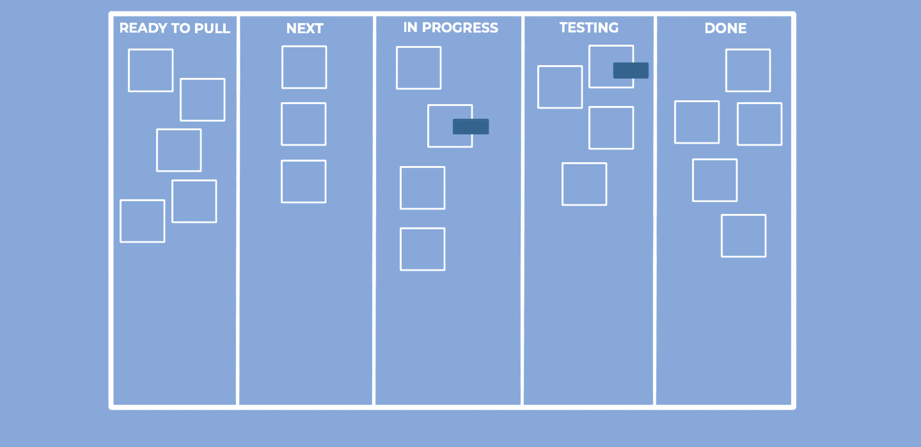
Kanban
GIT & Project Management

Slide 21
Kanban
GIT & Project Management
Imagine stickynotes of tasks that need to be done
Pros:
Visual
Cons:
Less Structured
Unintentional bottlenecks
Applying The Scenario:
Get a whiteboard and create a table with columns for “TODO”, “Doing”, “Done”
In TODO, write tasks such as “write intro”, “write paragraph 3”, “write conclusion”, etc.
Every team member assigns themselves a TODO task and moves it to Doing, then Done
Repeat until everything’s done

Slide 22
Planning + Estimation
GIT & Project Management
Generally, all assigned tasks are given “points” to help fairly distribute tasks and plan
Some common methods:
T-Shirt Sizing
Tasks are assigned sizes like:
XS (Extra Small)
S (Small)
M (Medium)
L (Large)
XL (Extra Large)
Quick + intuitive, less commitment pressure, good for early planning
Time-Based Estimation
Tasks are assigned by time to complete. Can be in hours or days. Used to set clear time boundaries.
Not that common in Agile, due to variability in a given task.
Story Points
Tasks are assigned by effort (not by time). Points are typically in a Fibonacci sequence.
Higher numbers = more effort
Factors in complexity, risk, and uncertainty.

Slide 23


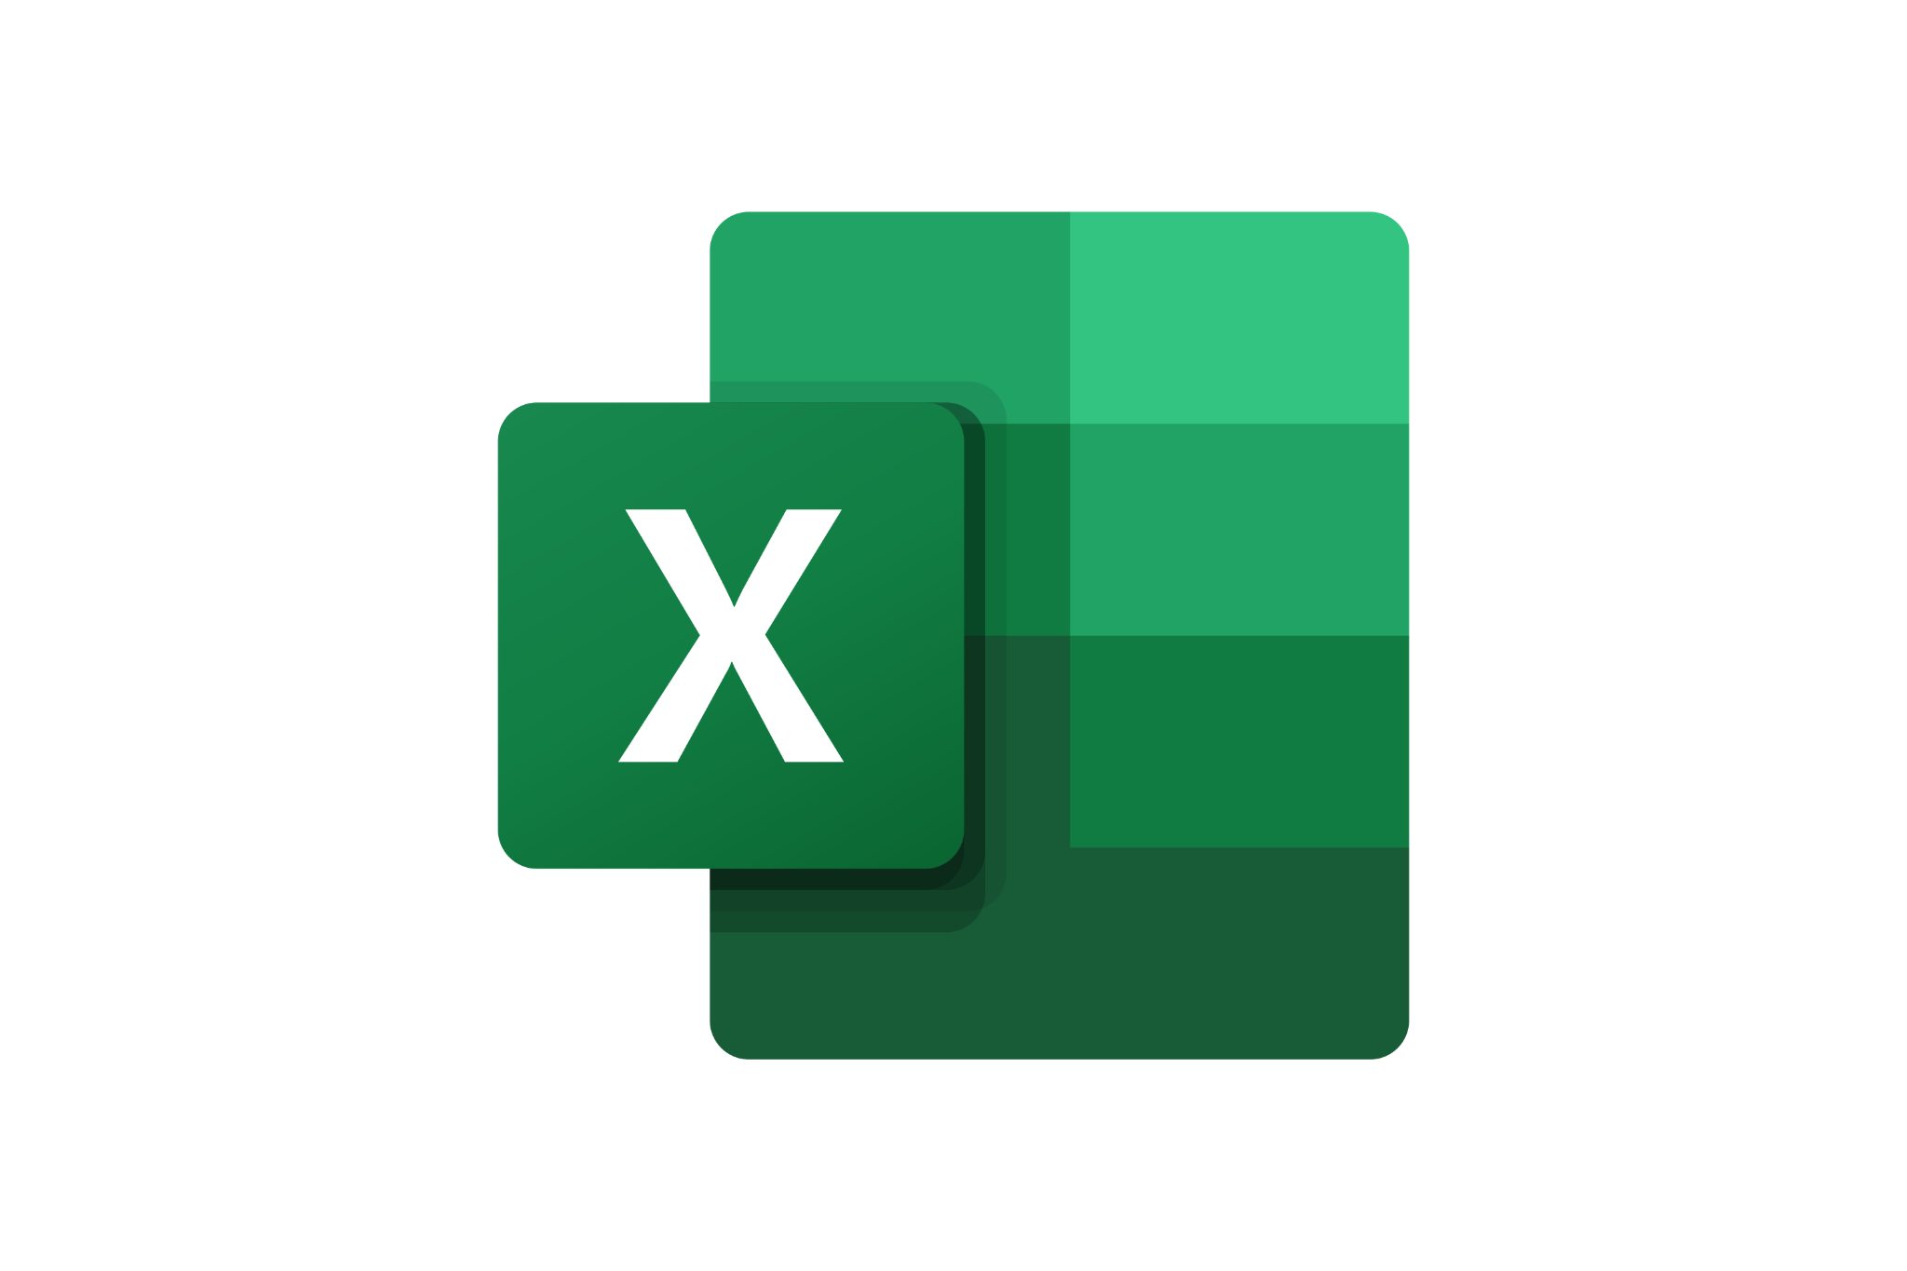

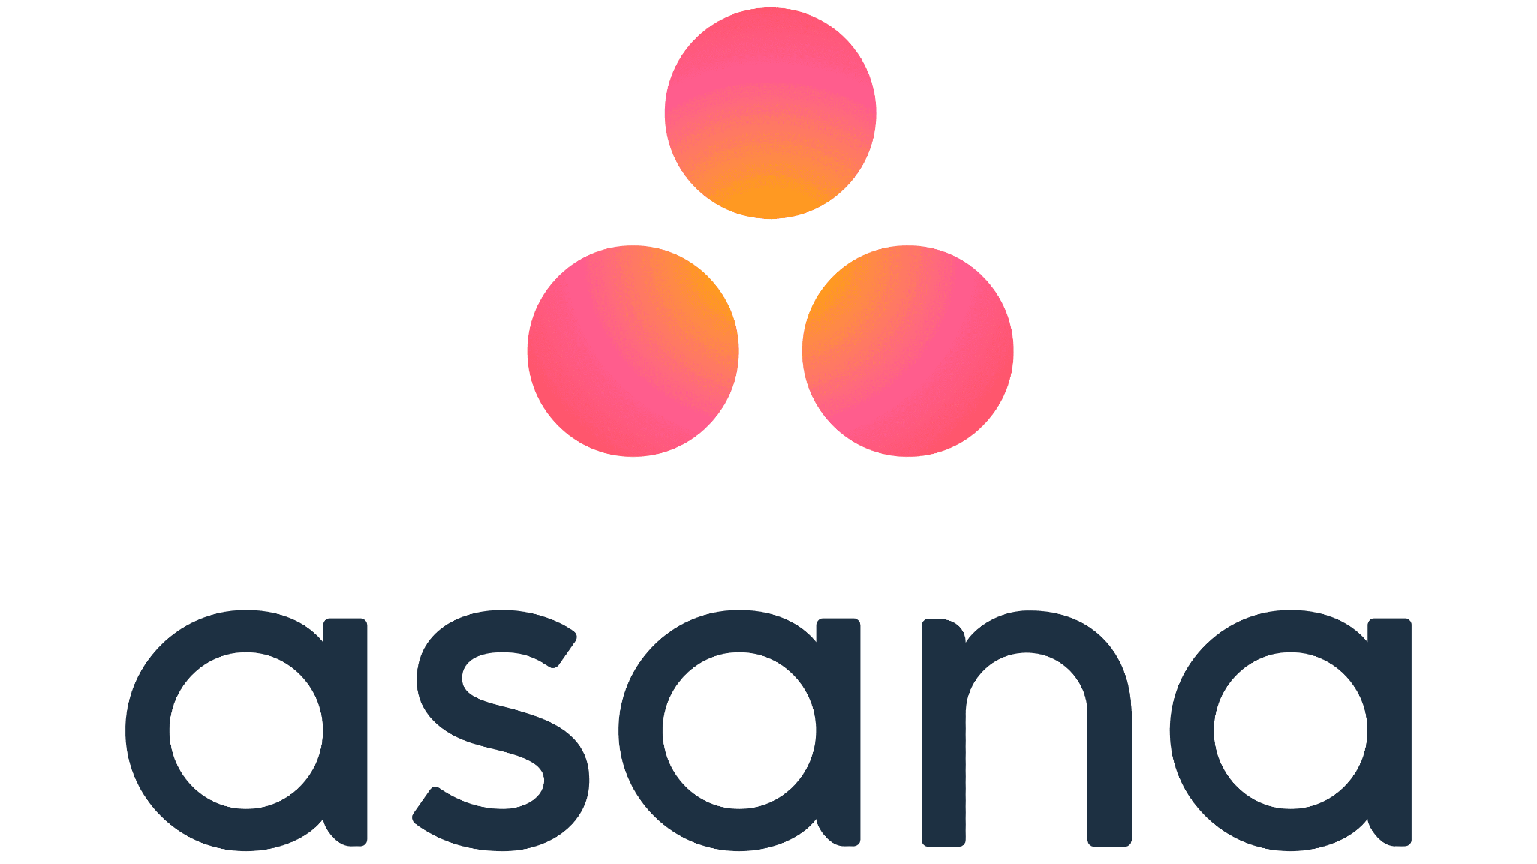
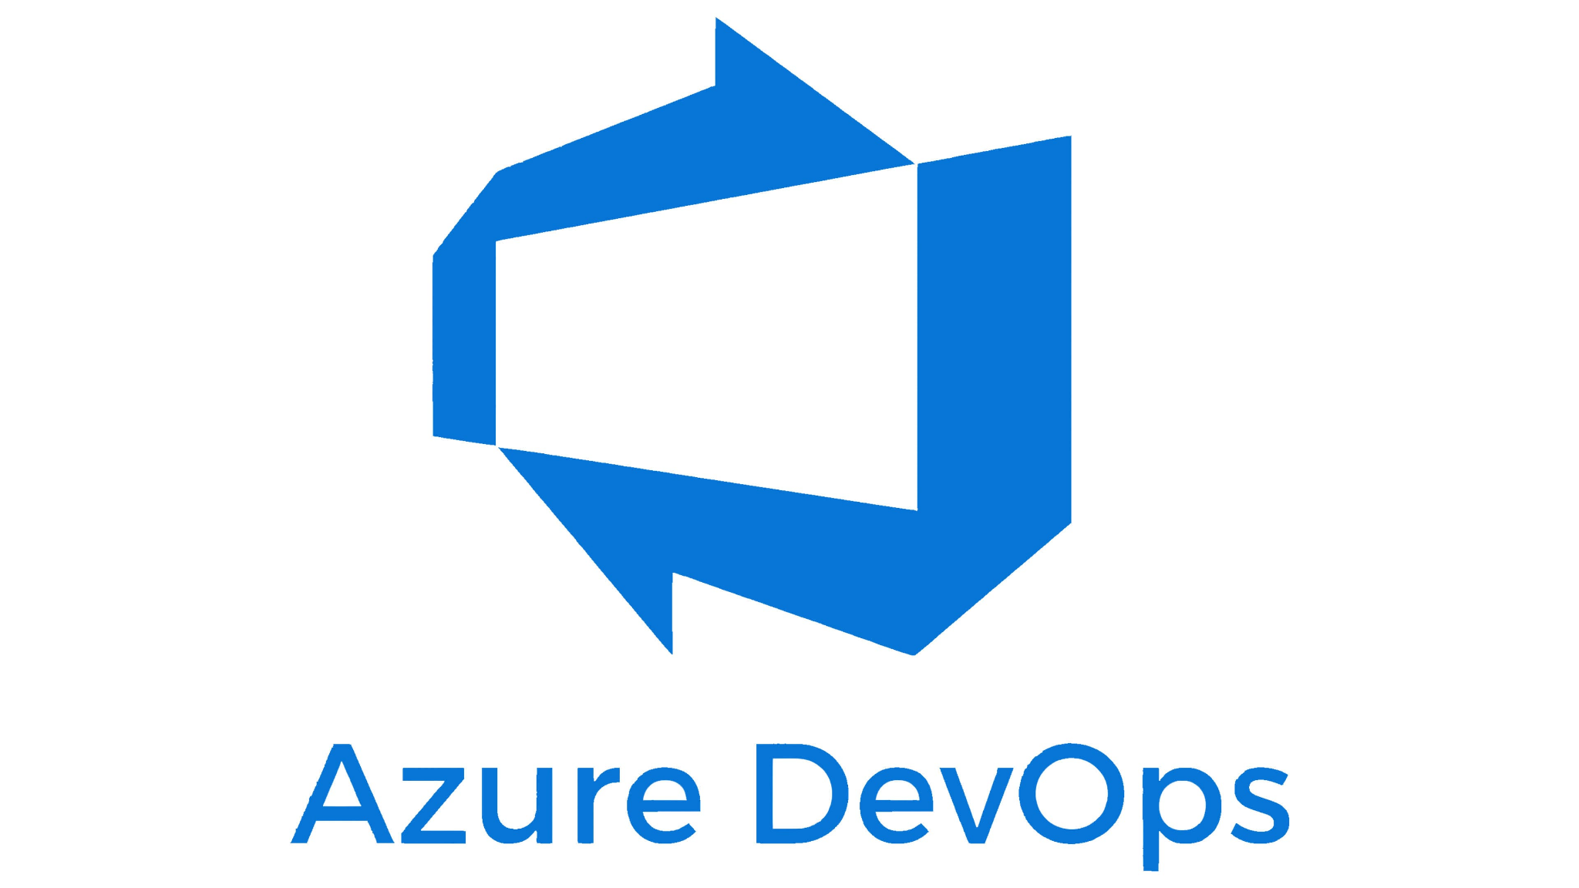


Tools
GIT & Project Management

Slide 24

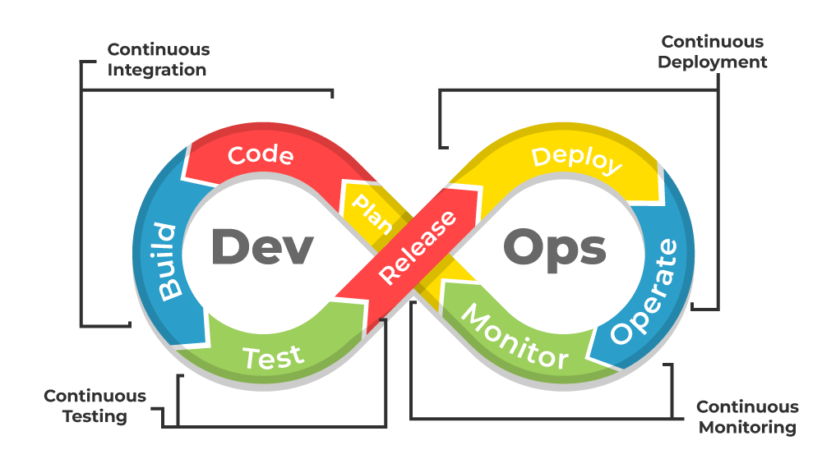
Automating The Process | DevOps
GIT & Project Management

Slide 25
DevOps
GIT & Project Management
Applying The Scenario:
Use Microsoft Word to track version changes
Add auto-formatting, grammar checking, and citation generators
Auto-generate pdfs + submit papers on a timeline
Track and tackle a queue of feedback
Imagine having to write 50 papers in a semester, you want automation!
DevOps works with the previous project management frameworks we discussed to automate delivery

Slide 26
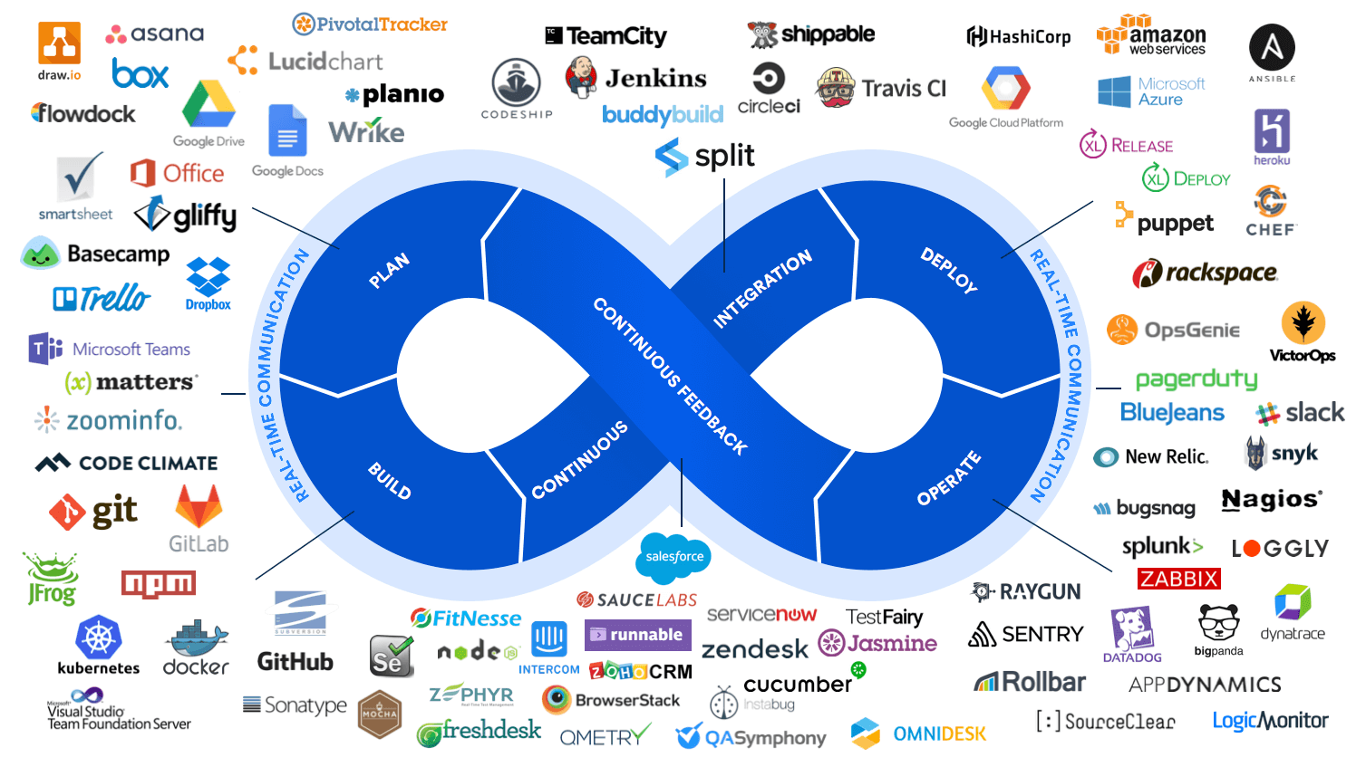
DevOps Tools
GIT & Project Management

Slide 27
Monitoring + Reporting
GIT & Project Management
Track progress, identify bottlenecks, ensure deadlines and standards will be met
Some common methods:
T-Shirt Sizing
Tasks are assigned sizes like:
XS (Extra Small)
S (Small)
M (Medium)
L (Large)
XL (Extra Large)
Quick + intuitive, less commitment pressure, good for early planning
Time-Based Estimation
Tasks are assigned by time to complete. Can be in hours or days. Used to set clear time boundaries.
Not that common in Agile, due to variability in a given task.
Story Points
Tasks are assigned by effort (not by time). Points are typically in a Fibonacci sequence.
Higher numbers = more effort
Factors in complexity, risk, and uncertainty.

Slide 28
Monitoring + Reporting
GIT & Project Management
Track progress, identify bottlenecks, ensure deadlines and standards will be met
Some common tools:
Gantt Chart
Visualizes project schedule over time. Shows task durations, dependencies, and milestones. Helps track progress against deadlines.
Useful for waterfall or structured project planning
Burn-Down Chart
Tracks remaining work over time in a sprint or project. Visualize progress toward sprint goals and highlights scope creep or velocity issues.
Ideal for Agile/Scrum teams
Kanban + Project Dashboards
Visual task management using columns (e.g., To Do, Doing, Done). Promotes continuous delivery and flow. Helps identify bottlenecks in real-time
Great for teams needing flexibility and visibility

Slide 29
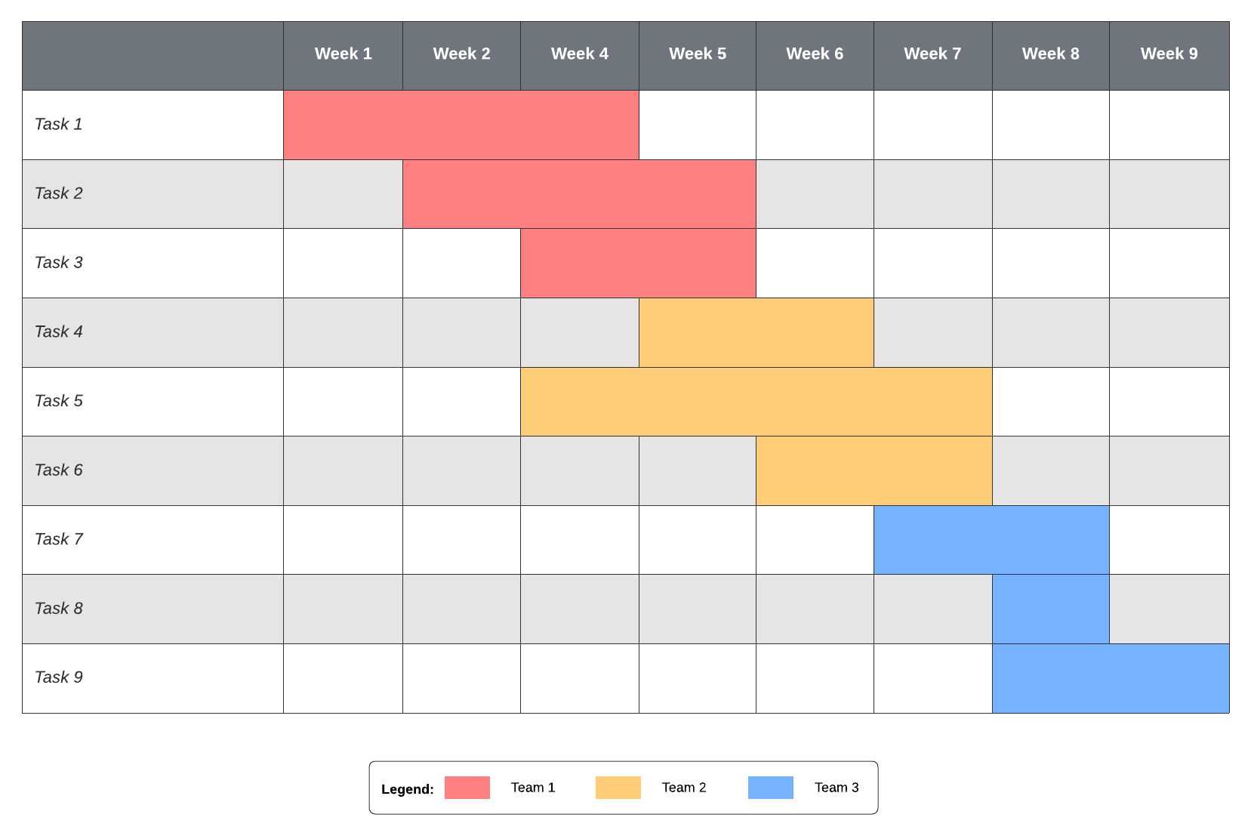
Monitoring + Reporting
GIT & Project Management
Gantt Chart

Slide 30
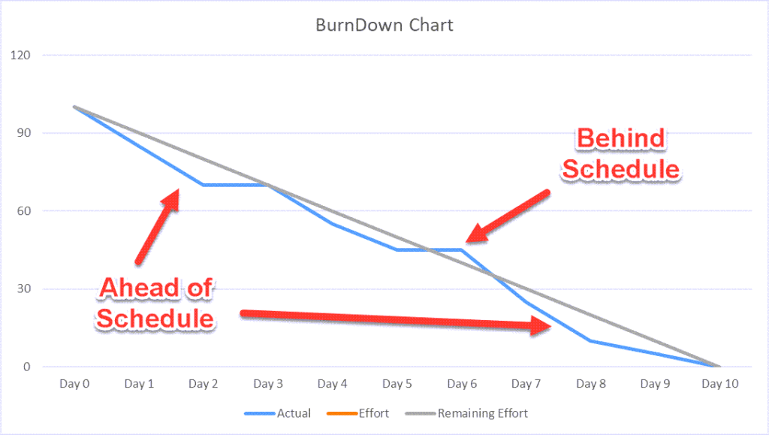
Monitoring + Reporting
GIT & Project Management
Burn-Down Chart
Remaining Work
Examples Include:
Hours
Story Points
# of Tasks
… etc.

Slide 31

Lab

Slide 32
Thank you
Questions? Contact
phuthai@microsoft.com

